Slide 1

Technology Supporting
Public Safety
ALPR Updates, Accountability, and Successes

Slide 2
Proposed alpr policy updates
General Order 400-32
ALPR data may only be shared for legitimate law enforcement purposes
Can only be requested by law enforcement agency or prosecutorial body
The ALPR coordinator will prepare and submit annual report no later than January 31st . The report will notate:
Program effectiveness
Potential training needs
Necessary policy changes or updates
Any issues found with audits and/or queries
The Chief of Police will submit an annual report to the Public Safety Committee no later than February 28th. The annual report will contain at a minimum:
Total plate reads
Total hot list alerts
Stolen vehicle recoveries
Missing persons located and missing person cases assisted
Criminal investigations aided
Number search warrants conducted
Number of arrest warrants obtained

Slide 3
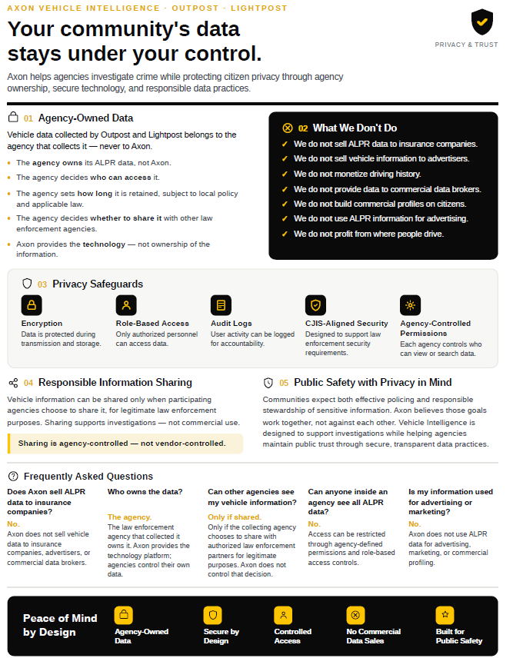
Axon Accountability assurances

Slide 4
Local Success Stories
Transylvania county Sheriff’s Office
  Missing Person Cases Assisted: 21 ( 7 found locally / 14 assists)
  Suicidal Persons – able to locate numerous subjects with suicidal ideations and make contact before self-harm
  Identify and locate several wanted persons
  Recovered multitude of stolen vehicles
  Recovery of thousands of dollars worth of stolen goods
  Identified suspect responsible for shooting into home

Slide 5
Local Success Stories
Henderson county Sheriff’s Office
On 05/18/2026, HCSO tracked a suspect in the homicide of a minor.
  Didn’t have a vehicle registration number but had a vehicle description.
  Ran ALPR searches of vehicles until we found one matching the description that was constantly going further from NC and towards Mexico.
  Linked up with Louisiana SHP, who had assisted us during Helene, and ended up getting the vehicle stopped just short of LA / TX state line.
In December 2024, HCSO received notification of a wanted suspect from Krenshaw Co. SC, subject was wanted for murder.
  Used that to locate the suspect vehicle and perform a stop. A foot pursuit resulted from this stop and an arrest with extradition back to SC.
Between May 1, 2025, and May 26, 2026
  Missing Persons Located: 2
  Arrests: 46
  Stolen Vehicles Recovered: 16
  Stolen Firearms Recovered: 1

Slide 6
Local Success Stories
Hendersonville Police Department
Detectives used ALPRs to identify and track a vehicle that was used in a gas station robbery resulting in two people being charged with the robbery.
Traffic units used ALPRs to identify and track down the operator of a vehicle who struck a building and left the scene.
Officers used ALPRs to locate and arrest an individual wanted for felony assault.
Officers used ALPRs to locate an elderly male in the early stages of dementia who had left his home without any means of being tracked. He was located within 30 minutes.
Officers used ALPRs to locate a missing juvenile who had uncharacteristically left work without notification to parents.

Slide 7
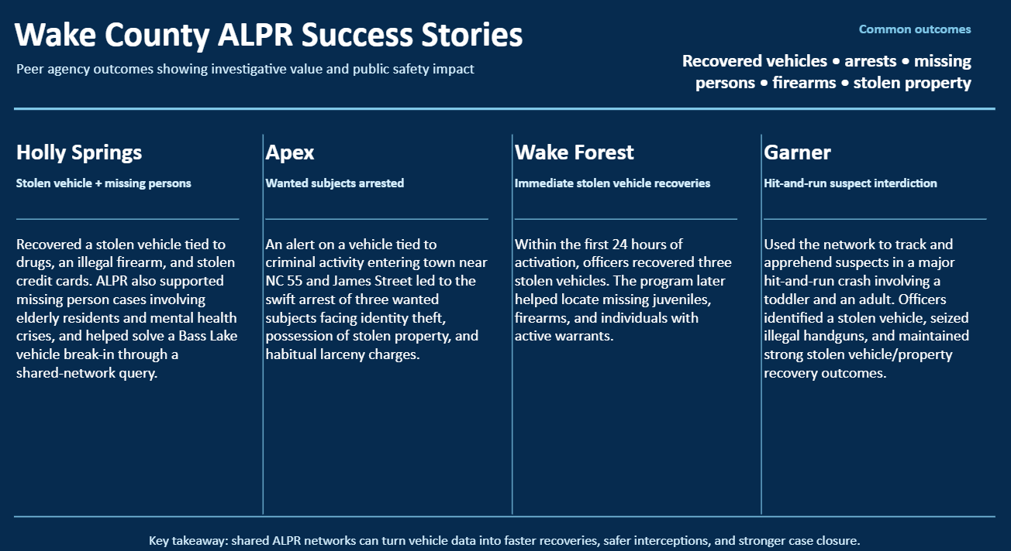
Regional Success Stories

Slide 8
Accountability
TCSO reports zero (0) ALPR related policy violations
HCSO reports zero (0) ALPR related policy violations
HPD reports zero (0) ALPR related policy violations
Apex PD reports zero (0) ALPR related policy violations

Slide 9
Questions?

